Slide 1



Social Buzz
Analysis

Slide 2


Today's agenda
Project recap
Problem
The Analytics team
Process
Insights
Summary

Slide 3

Social Buzz, a social media and content creation company. With over 500 million active users monthly, Social Buzz has experienced rapid growth and needs assistance in managing their expanding operations. To initiate the engagement, a three-month project has been proposed. They seek external expertise for three main reasons:
guidance for a planned IPO
help with scaling their operations
learning data best practices from established corporations
Project Recap

Slide 4

Problem
Every day over 100,000 pieces of content
36,500,000 of content per year
How to make capital out of so much data ?
Analysis to find Top 5 Social Buzz most popular categories for content

Slide 5



Andrew Fleming
Chief Technology Architect
The Analytics team
Marcus Rompton
Senior Principal
Deepanshu
Data Analyst

Slide 6
Process
1
Data Understanding
2
Data Cleaning
3
Data Modelling
4
Data Analysis
5
Insights

Slide 7

Insights
16
Unique Categories
1897
reaction to animal category
May
Month with most post

Slide 8
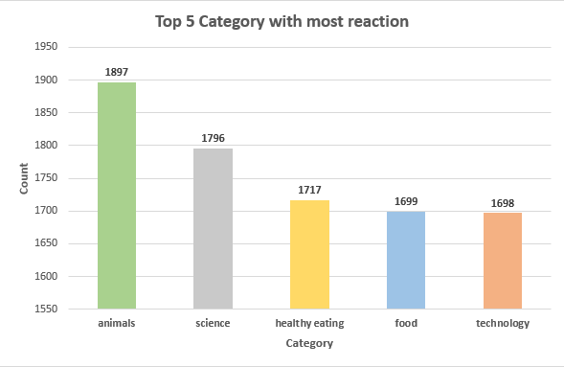

Slide 9
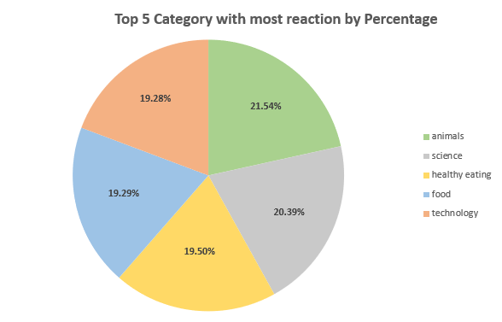

Slide 10

Analysis
Animals and Science are the two most popular content categories, indicating that consumers are more interested in 'real-life' and 'factual' information.
Insight
Food is a frequent theme in the top five categories, with 'healthy eating' scoring highest. This gives us insight into the client so that we may create a campaign for 'healthy eating' to increase user engagement
Summary
Next Step
This study is informative, but it's time to apply it on a larger scale in the real world to better understand and build your business.

Slide 11
Thank you!
ANY QUESTIONS?

